Slide 1
Computer Engineering
turning silicon and logic into possibility

Slide 2
Computer Engineering blends the principles of computer hardware, digital systems, and the integration of hardware and software

Slide 3
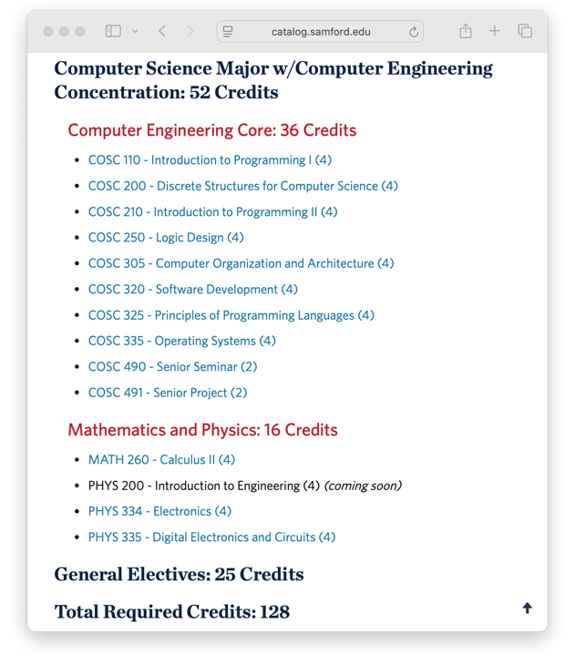
Curriculum
Integration of hardware and software.

Slide 4
Curriculum
Integration of hardware and software.

Slide 5
Curriculum
Integration of hardware and software.

Slide 6
Computer Engineering Careers
Hardware
Design
Embedded Systems
Systems Integration
Alum at Dell

Slide 7
Demo Time!
Goal: measure lateral passing distances
Hot research
  https://mybiketraffic.com/ - 100,000 users in 99 different countries
  First person to build an entire framework for collecting radar data
  Swedish, British, Norwegian, and Australian
  governments are interested in my work
  Mainly because of the demo I’m about to do!

Slide 8
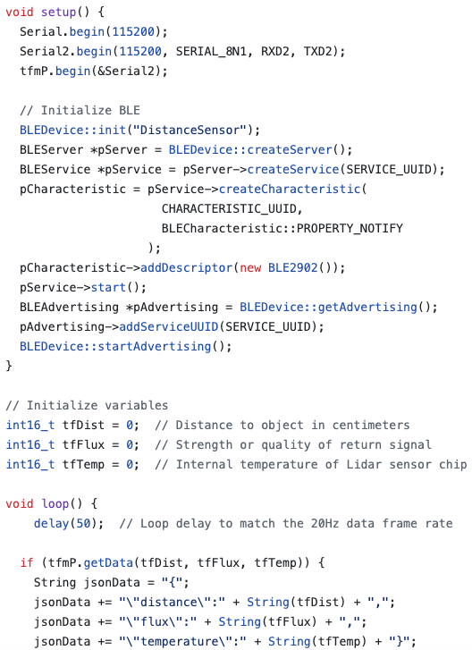
Arduino code

Slide 9
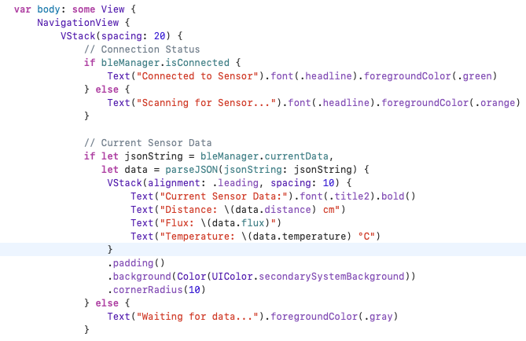
iOS app

Slide 10
Find out more? Questions?
https://cs.briantoone.com
brtoone@samford.edu
205.902.6779 (text)
205.726.2960 (office phone)

